Slide 1
Insertion Sort and Its Analysis

Slide 2
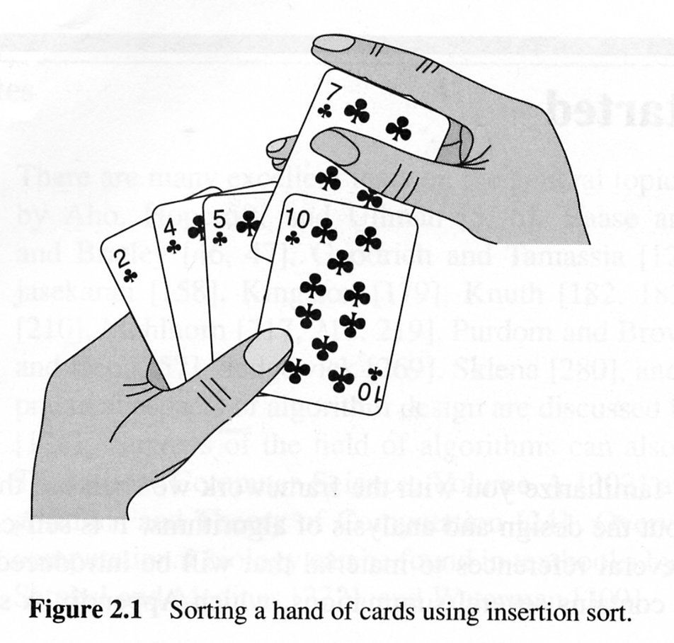
Insertion sort algorithm

Slide 3
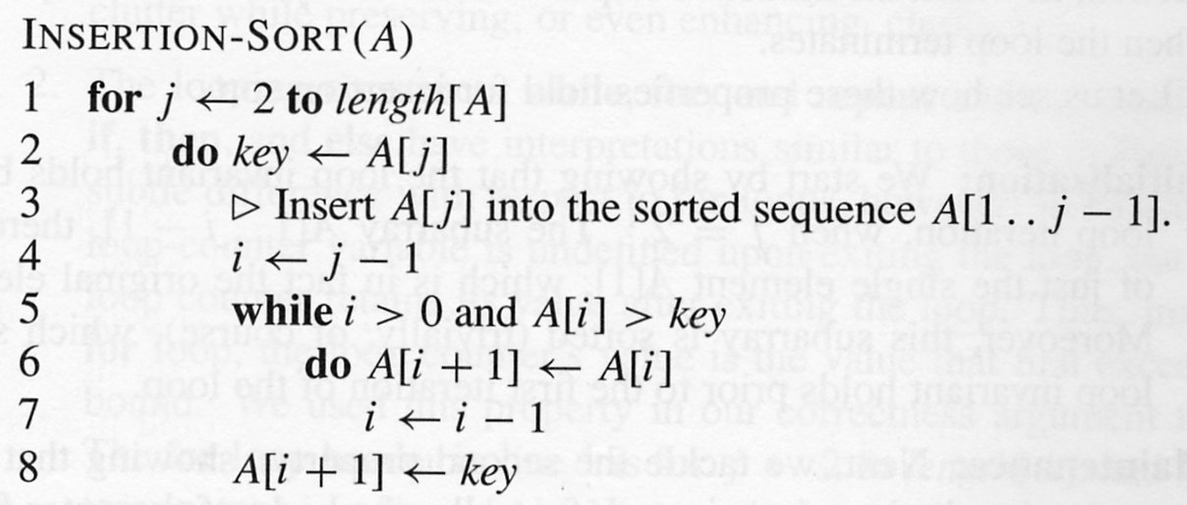
Insertion sort pseudocode

Slide 4
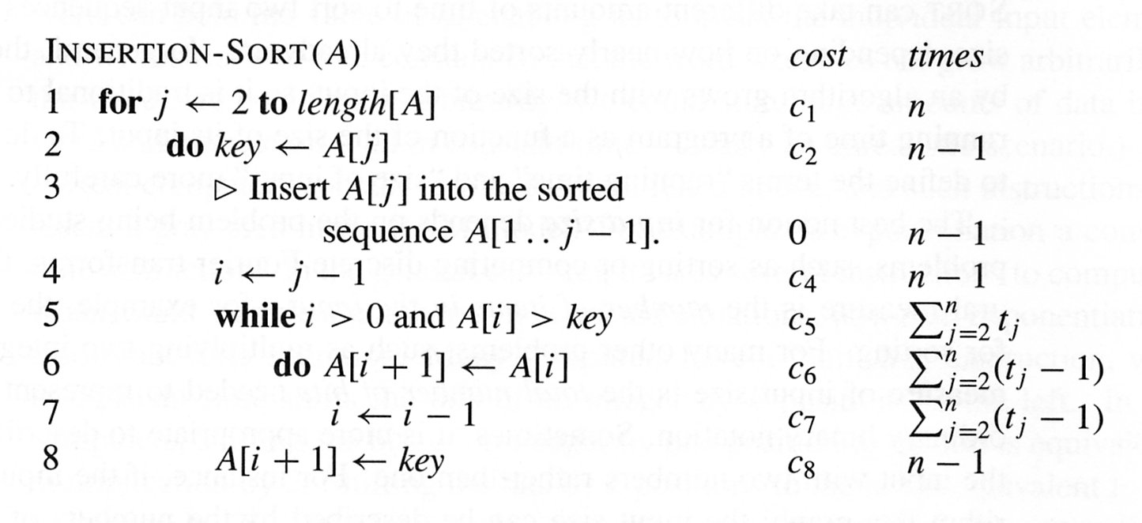
Running time analysis

Slide 5
Best case analysis
T(n) = c₁n + c₂(n-1) + c₄(n-1) + c₅(n-1) +c₈(n-1)
T(n) is a linear function of n

Slide 6
Worst-case analysis (array reverse-sorted)
Must compare each element A[j] with each element in the entire sorted sub-array A[1..j-1]
So T(j) = j, for j = 2,3,…,n
Thus, T(n) = c1n + c2(n-1) + c4(n-1) + c5(n(n+1)/2 – 1)
+ c6(n(n-1)/2) + c7(n(n-1)/2) + c8(n-1)
T(n) is a quadratic function of n

Slide 7
Insertion Sort
Iteration i. Repeatedly swap element i with the one to its left if smaller.
Property. After ith iteration, a[0] through a[i] contain first i+1 elements in ascending order.
Array index
0
1
2
3
4
5
6
7
8
9
Value
2.78
7.42
0.56
1.12
1.17
0.32
6.21
4.42
3.14
7.71
Iteration 0: step 0.

Slide 8
Insertion Sort
Iteration i. Repeatedly swap element i with the one to its left if smaller.
Property. After ith iteration, a[0] through a[i] contain first i+1 elements in ascending order.
Array index
0
1
2
3
4
5
6
7
8
9
Value
2.78
7.42
0.56
1.12
1.17
0.32
6.21
4.42
3.14
7.71
Iteration 1: step 0.

Slide 9
Insertion Sort
Iteration i. Repeatedly swap element i with the one to its left if smaller.
Property. After ith iteration, a[0] through a[i] contain first i+1 elements in ascending order.
Array index
0
1
2
3
4
5
6
7
8
9
Value
2.78
7.42
0.56
0.56
7.42
1.12
1.17
0.32
6.21
4.42
3.14
7.71
Iteration 2: step 0.

Slide 10
Insertion Sort
Iteration i. Repeatedly swap element i with the one to its left if smaller.
Property. After ith iteration, a[0] through a[i] contain first i+1 elements in ascending order.
Array index
0
1
2
3
4
5
6
7
8
9
Value
2.78
0.56
0.56
2.78
7.42
1.12
1.17
0.32
6.21
4.42
3.14
7.71
Iteration 2: step 1.

Slide 11
Insertion Sort
Iteration i. Repeatedly swap element i with the one to its left if smaller.
Property. After ith iteration, a[0] through a[i] contain first i+1 elements in ascending order.
Array index
0
1
2
3
4
5
6
7
8
9
Value
0.56
2.78
7.42
1.12
1.17
0.32
6.21
4.42
3.14
7.71
Iteration 2: step 2.

Slide 12
Insertion Sort
Iteration i. Repeatedly swap element i with the one to its left if smaller.
Property. After ith iteration, a[0] through a[i] contain first i+1 elements in ascending order.
Array index
0
1
2
3
4
5
6
7
8
9
Value
0.56
2.78
7.42
1.12
1.12
7.42
1.17
0.32
6.21
4.42
3.14
7.71
Iteration 3: step 0.

Slide 13
Insertion Sort
Iteration i. Repeatedly swap element i with the one to its left if smaller.
Property. After ith iteration, a[0] through a[i] contain first i+1 elements in ascending order.
Array index
0
1
2
3
4
5
6
7
8
9
Value
0.56
2.78
1.12
1.12
2.78
7.42
1.17
0.32
6.21
4.42
3.14
7.71
Iteration 3: step 1.

Slide 14
Insertion Sort
Iteration i. Repeatedly swap element i with the one to its left if smaller.
Property. After ith iteration, a[0] through a[i] contain first i+1 elements in ascending order.
Array index
0
1
2
3
4
5
6
7
8
9
Value
0.56
1.12
2.78
7.42
1.17
0.32
6.21
4.42
3.14
7.71
Iteration 3: step 2.

Slide 15
Insertion Sort
Iteration i. Repeatedly swap element i with the one to its left if smaller.
Property. After ith iteration, a[0] through a[i] contain first i+1 elements in ascending order.
Array index
0
1
2
3
4
5
6
7
8
9
Value
0.56
1.12
2.78
7.42
1.17
1.17
7.42
0.32
6.21
4.42
3.14
7.71
Iteration 4: step 0.

Slide 16
Insertion Sort
Iteration i. Repeatedly swap element i with the one to its left if smaller.
Property. After ith iteration, a[0] through a[i] contain first i+1 elements in ascending order.
Array index
0
1
2
3
4
5
6
7
8
9
Value
0.56
1.12
2.78
1.17
1.17
2.78
7.42
0.32
6.21
4.42
3.14
7.71
Iteration 4: step 1.

Slide 17
Insertion Sort
Iteration i. Repeatedly swap element i with the one to its left if smaller.
Property. After ith iteration, a[0] through a[i] contain first i+1 elements in ascending order.
Array index
0
1
2
3
4
5
6
7
8
9
Value
0.56
1.12
1.17
2.78
7.42
0.32
6.21
4.42
3.14
7.71
Iteration 4: step 2.

Slide 18
Insertion Sort
Iteration i. Repeatedly swap element i with the one to its left if smaller.
Property. After ith iteration, a[0] through a[i] contain first i+1 elements in ascending order.
Array index
0
1
2
3
4
5
6
7
8
9
Value
0.56
1.12
1.17
2.78
7.42
0.32
0.32
7.42
6.21
4.42
3.14
7.71
Iteration 5: step 0.

Slide 19
Insertion Sort
Iteration i. Repeatedly swap element i with the one to its left if smaller.
Property. After ith iteration, a[0] through a[i] contain first i+1 elements in ascending order.
Array index
0
1
2
3
4
5
6
7
8
9
Value
0.56
1.12
1.17
2.78
0.32
0.32
2.78
7.42
6.21
4.42
3.14
7.71
Iteration 5: step 1.

Slide 20
Insertion Sort
Iteration i. Repeatedly swap element i with the one to its left if smaller.
Property. After ith iteration, a[0] through a[i] contain first i+1 elements in ascending order.
Array index
0
1
2
3
4
5
6
7
8
9
Value
0.56
1.12
1.17
0.32
0.32
1.17
2.78
7.42
6.21
4.42
3.14
7.71
Iteration 5: step 2.

Slide 21
Insertion Sort
Iteration i. Repeatedly swap element i with the one to its left if smaller.
Property. After ith iteration, a[0] through a[i] contain first i+1 elements in ascending order.
Array index
0
1
2
3
4
5
6
7
8
9
Value
0.56
1.12
0.32
0.32
1.12
1.17
2.78
7.42
6.21
4.42
3.14
7.71
Iteration 5: step 3.

Slide 22
Insertion Sort
Iteration i. Repeatedly swap element i with the one to its left if smaller.
Property. After ith iteration, a[0] through a[i] contain first i+1 elements in ascending order.
Array index
0
1
2
3
4
5
6
7
8
9
Value
0.56
0.32
0.32
0.56
1.12
1.17
2.78
7.42
6.21
4.42
3.14
7.71
Iteration 5: step 4.

Slide 23
Insertion Sort
Iteration i. Repeatedly swap element i with the one to its left if smaller.
Property. After ith iteration, a[0] through a[i] contain first i+1 elements in ascending order.
Array index
0
1
2
3
4
5
6
7
8
9
Value
0.32
0.56
1.12
1.17
2.78
7.42
6.21
4.42
3.14
7.71
Iteration 5: step 5.

Slide 24
Insertion Sort
Iteration i. Repeatedly swap element i with the one to its left if smaller.
Property. After ith iteration, a[0] through a[i] contain first i+1 elements in ascending order.
Array index
0
1
2
3
4
5
6
7
8
9
Value
0.32
0.56
1.12
1.17
2.78
7.42
6.21
6.21
7.42
4.42
3.14
7.71
Iteration 6: step 0.

Slide 25
Insertion Sort
Iteration i. Repeatedly swap element i with the one to its left if smaller.
Property. After ith iteration, a[0] through a[i] contain first i+1 elements in ascending order.
Array index
0
1
2
3
4
5
6
7
8
9
Value
0.32
0.56
1.12
1.17
2.78
6.21
7.42
4.42
3.14
7.71
Iteration 6: step 1.

Slide 26
Insertion Sort
Iteration i. Repeatedly swap element i with the one to its left if smaller.
Property. After ith iteration, a[0] through a[i] contain first i+1 elements in ascending order.
Array index
0
1
2
3
4
5
6
7
8
9
Value
0.32
0.56
1.12
1.17
2.78
6.21
7.42
4.42
4.42
7.42
3.14
7.71
Iteration 7: step 0.

Slide 27
Insertion Sort
Iteration i. Repeatedly swap element i with the one to its left if smaller.
Property. After ith iteration, a[0] through a[i] contain first i+1 elements in ascending order.
Array index
0
1
2
3
4
5
6
7
8
9
Value
0.32
0.56
1.12
1.17
2.78
6.21
4.42
4.42
6.21
7.42
3.14
7.71
Iteration 7: step 1.

Slide 28
Insertion Sort
Iteration i. Repeatedly swap element i with the one to its left if smaller.
Property. After ith iteration, a[0] through a[i] contain first i+1 elements in ascending order.
Array index
0
1
2
3
4
5
6
7
8
9
Value
0.32
0.56
1.12
1.17
2.78
4.42
6.21
7.42
3.14
7.71
Iteration 7: step 2.

Slide 29
Insertion Sort
Iteration i. Repeatedly swap element i with the one to its left if smaller.
Property. After ith iteration, a[0] through a[i] contain first i+1 elements in ascending order.
Array index
0
1
2
3
4
5
6
7
8
9
Value
0.32
0.56
1.12
1.17
2.78
4.42
6.21
7.42
3.14
3.14
7.42
7.71
Iteration 8: step 0.

Slide 30
Insertion Sort
Iteration i. Repeatedly swap element i with the one to its left if smaller.
Property. After ith iteration, a[0] through a[i] contain first i+1 elements in ascending order.
Array index
0
1
2
3
4
5
6
7
8
9
Value
0.32
0.56
1.12
1.17
2.78
4.42
6.21
3.14
3.14
6.21
7.42
7.71
Iteration 8: step 1.

Slide 31
Insertion Sort
Iteration i. Repeatedly swap element i with the one to its left if smaller.
Property. After ith iteration, a[0] through a[i] contain first i+1 elements in ascending order.
Array index
0
1
2
3
4
5
6
7
8
9
Value
0.32
0.56
1.12
1.17
2.78
4.42
3.14
3.14
4.42
6.21
7.42
7.71
Iteration 8: step 2.

Slide 32
Insertion Sort
Iteration i. Repeatedly swap element i with the one to its left if smaller.
Property. After ith iteration, a[0] through a[i] contain first i+1 elements in ascending order.
Array index
0
1
2
3
4
5
6
7
8
9
Value
0.32
0.56
1.12
1.17
2.78
3.14
4.42
6.21
7.42
7.71
Iteration 8: step 3.

Slide 33
Insertion Sort
Iteration i. Repeatedly swap element i with the one to its left if smaller.
Property. After ith iteration, a[0] through a[i] contain first i+1 elements in ascending order.
Array index
0
1
2
3
4
5
6
7
8
9
Value
0.32
0.56
1.12
1.17
2.78
3.14
4.42
6.21
7.42
7.71
Iteration 9: step 0.

Slide 34
Insertion Sort
Iteration i. Repeatedly swap element i with the one to its left if smaller.
Property. After ith iteration, a[0] through a[i] contain first i+1 elements in ascending order.
Array index
0
1
2
3
4
5
6
7
8
9
Value
0.32
0.56
1.12
1.17
2.78
3.14
4.42
6.21
7.42
7.71
Iteration 10: DONE.

